Slide 1









SQL PROJECT
MUSIC STORE ANALSIS
By Manvi Ahuja

Slide 2

OBJECTIVE:
Analyze a music records database, uncovering insights into customer behavior, genre popularity, top artists, and overall sales to support data-driven business decisions.

Slide 3
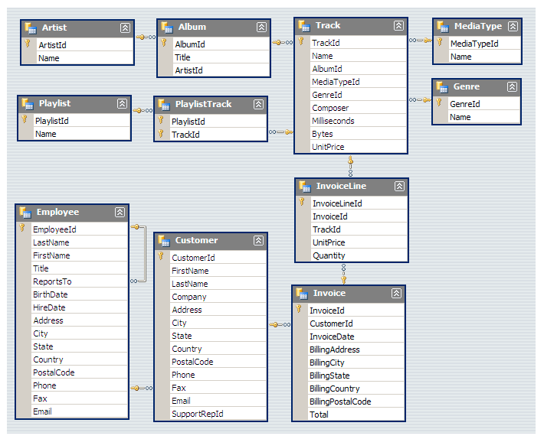

DATABASE SCHEMA

Slide 4

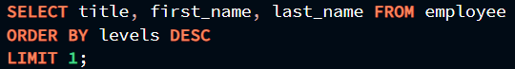

Who is the senior most employee based on job title?

Slide 5
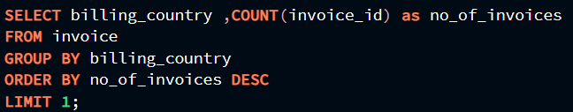

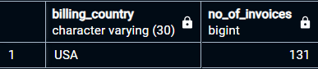
Which country has the most invoices?

Slide 6
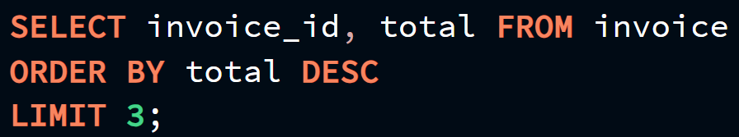

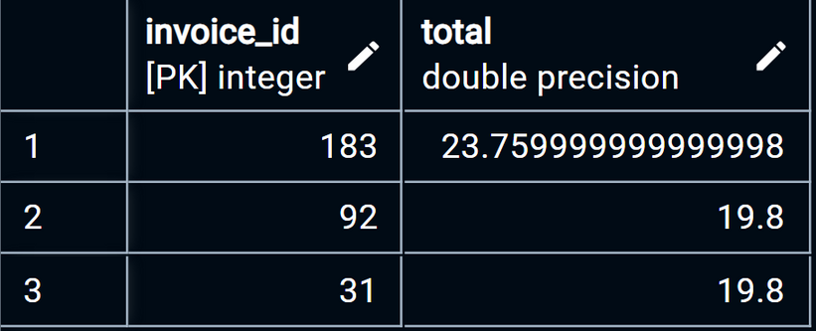
What are top three values of total invoice?

Slide 7
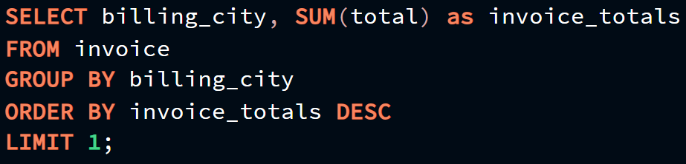

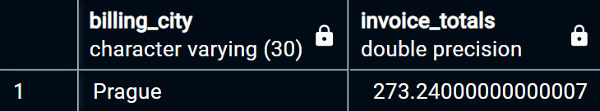
Which city has the best customers? We would like to throw a promotional
Music Festival in the city we made the most money. Write a query that
returns one city that has the highest sum of invoice totals. Return both the city name & sum of all invoice totals.

Slide 8
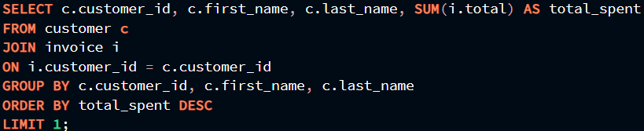
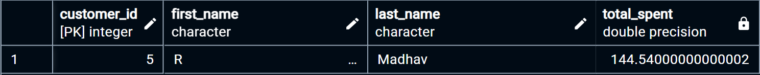
Who is the best customer? The customer who has spend the most money
will be declared as the best customer. Write a query that returns who has
spent the most money.

Slide 9
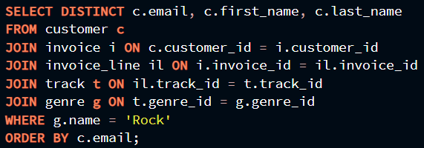

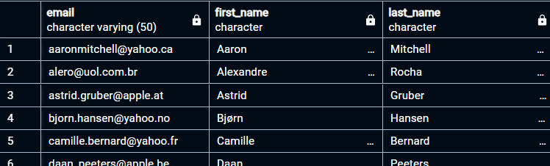
Write query to return the email, first_name, last_name and genre of all Rock Music Listeners. Return your list ordered alphabetically by email starting with A.

Slide 10
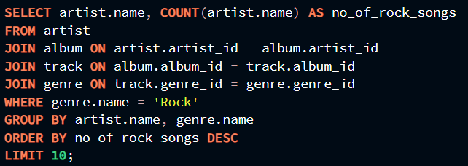

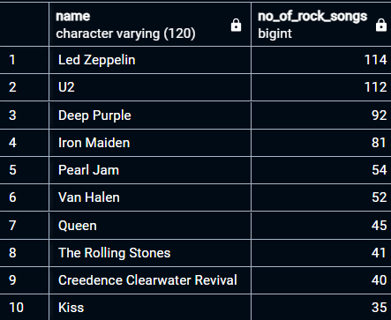
Let’s invite the artists who have written the most rock music in our
dataset. Write a query that returns the Artist name and total track count of the top 10 rock bands.

Slide 11
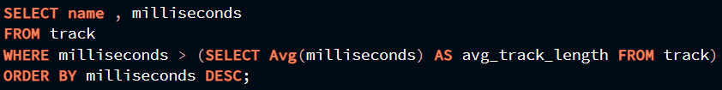

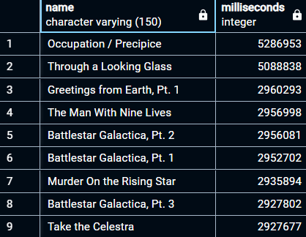
Return the track names that have a song length longer than the average song length. Return the Name and Milliseconds for each track. Order by the song length with the longest songs listed first.

Slide 12
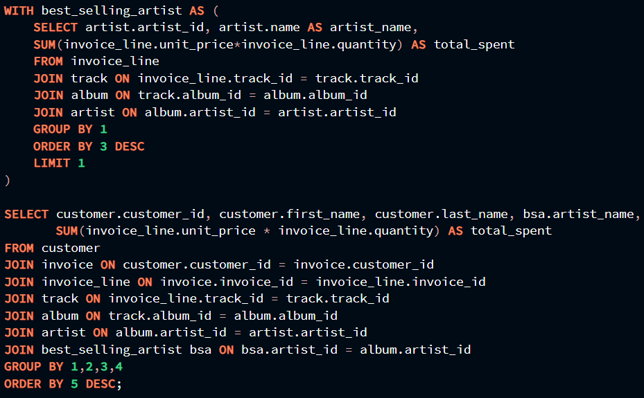

Find out how much each customer has spent on the artist who has generated the most revenue. Return the customer's ID, their name, the artist's name, and the total amount spent by each customer on that artist.

Slide 13
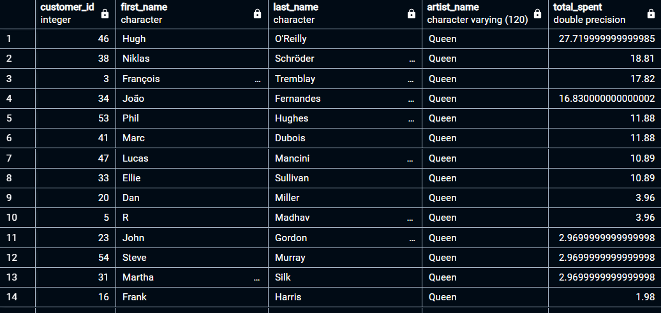
OUTPUT

Slide 14
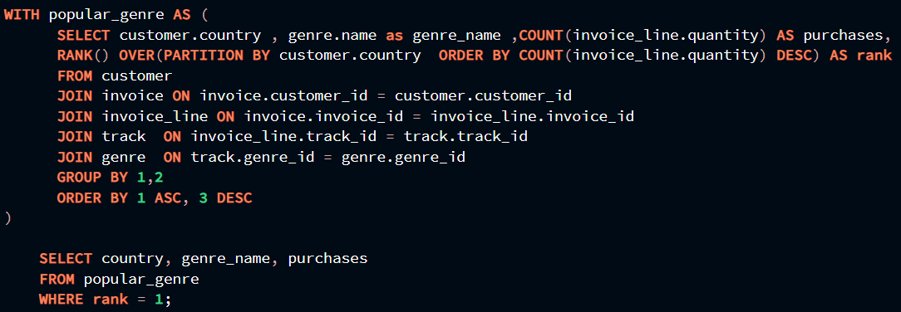
We want to find out the most popular music Genre for each country. We determine the most popular genre as the genre with the highest amount of purchases. Write a query that returns each country along with the top Genre. For countries where the maximum number of purchases is shared return all Genres.

Slide 15
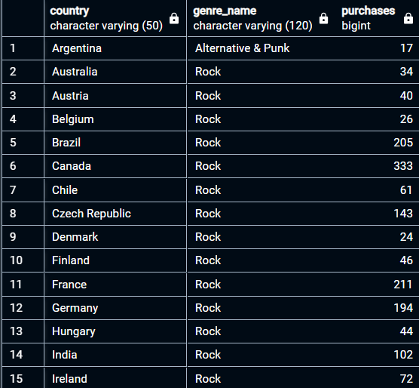

OUTPUT

Slide 16
Write a query that determines the customer that has spent the most on music for each country. Write a query that returns the country along with the top customer and how much they spent. For countries where the top amount spent is shared, provide all customers who spent this amount.

Slide 17
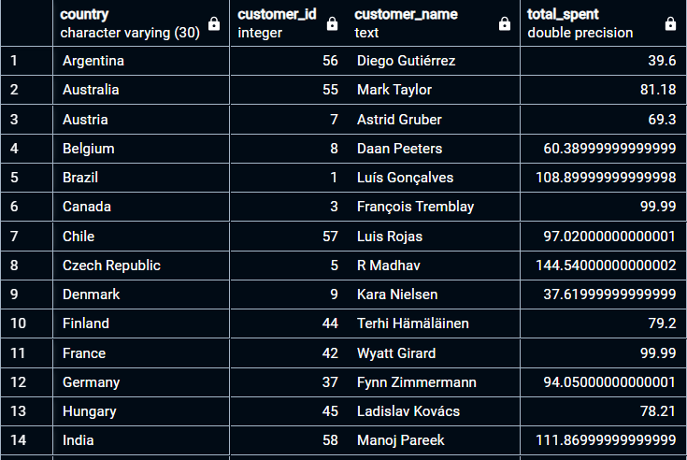
OUTPUT

Slide 18
KEY INSIGHTS
Top Employee: Identified the senior-most employee by job title.
Sales: Discovered the leading country and city by invoice count and revenue, respectively.
Customer Behavior: Highlighted the highest-spending customers and popular music genres by country.
Artist & Track Analysis: Found the most prolific rock bands and longest tracks, offering insights into content trends.

Slide 19





THANK YOU!

